Slide 1
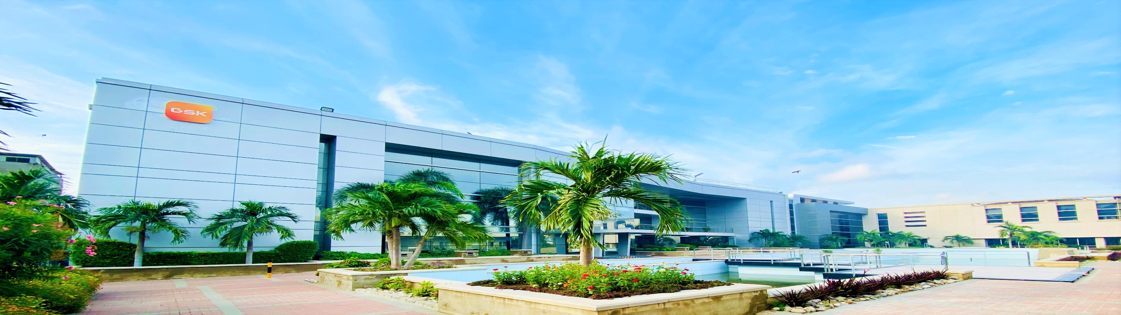
Welcome to Site Korangi

Slide 2
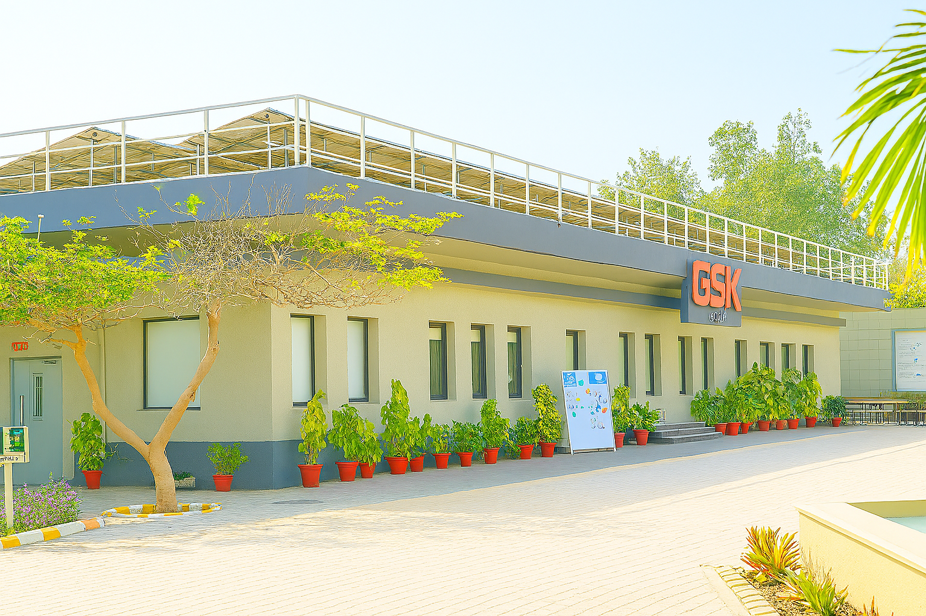
Efforts made by the site to engage stakeholders and coordinate and support public-sector agencies shall be identified.
Stakeholder name | Stakeholder description (businesses, governmental agency, farmers/landowners, supplier, non-governmental organizations, community-based organizations, etc.) | Stakeholder's Impact | Stakeholder's level of Interest in water-related issues
Residents of Mansehra colony | Residential/Community | Medium | Low
Karachi Water Supply and Sewerage Corporation (KWSC) | Government agency | High | High
Sindh Irrigation Department | Government agency | High | High
Swano Dry Cleaner | Industry | Low | Medium
Ghulam Nabi | Water Contractor | High | High
Korangi Association of Trade and Industries (KATI) | Trade Association | Medium | Medium
Pakitex Boards Pvt Ltd | Industry | Medium | High
Nestle Port Qasim Factory | Industry | Medium | High
WWF Pakistan | Non-governmental organization (NGO) | Low | High
Site Employees | GSK personnel | High | High
Artistic Garment Industries | Industry | Medium | High
Martin Dow International | Industry | Medium | High
Ghulam Nabi | Water Contractor | High | High

Slide 3
ENGAGEMENT (NESTLE PQF)

Slide 4
ENGAGEMENT (KATI)

Slide 5
ENGAGEMENT (SWANO DRY CLEANERS)

Slide 6
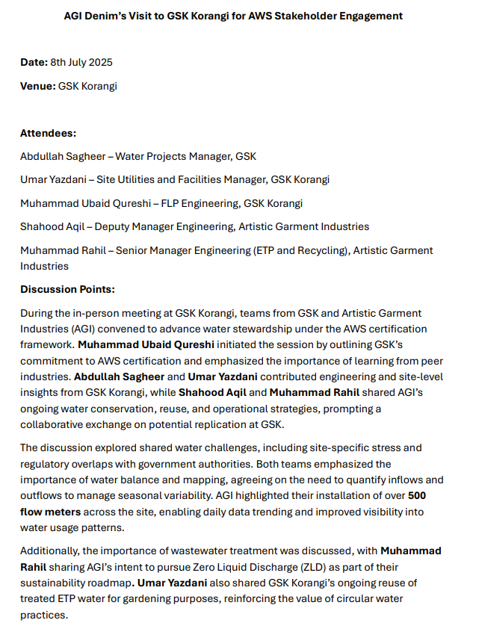
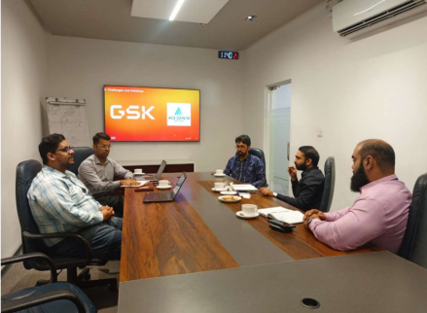
ENGAGEMENT (ARTISTIC GARMENT INDUSTRIES)

Slide 7
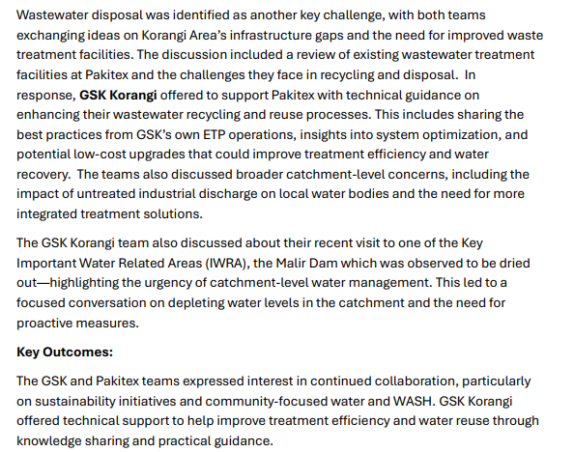
ENGAGEMENT (PAKITEX BOARDS)

Slide 8
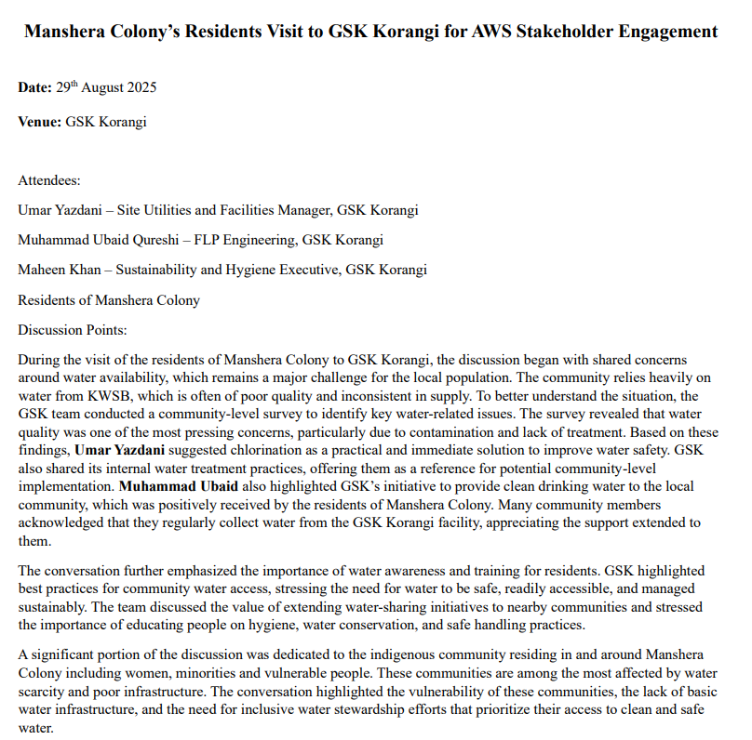
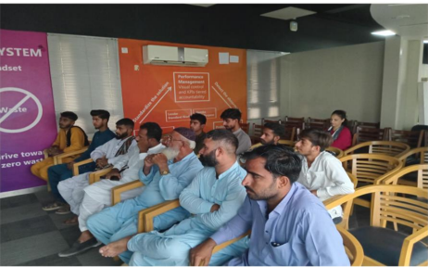
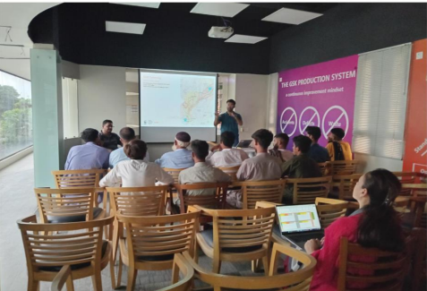
ENGAGEMENT (MANSEHRA COLONY)

Slide 9
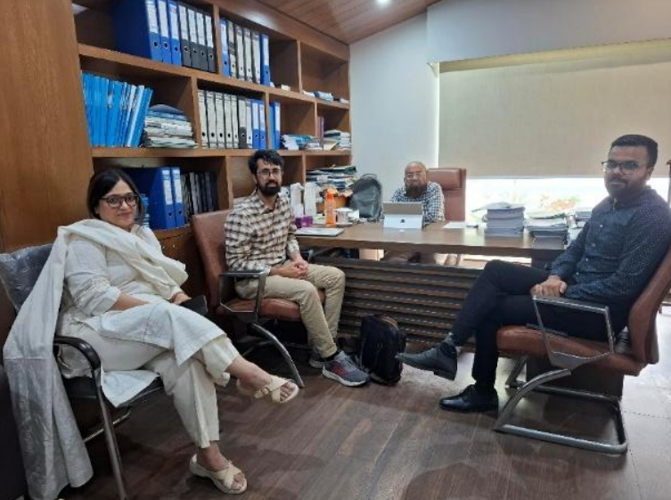
ENGAGEMENTS (SITE ASSOCIATION)
ENGAGEMENT (KWSC)

Slide 10
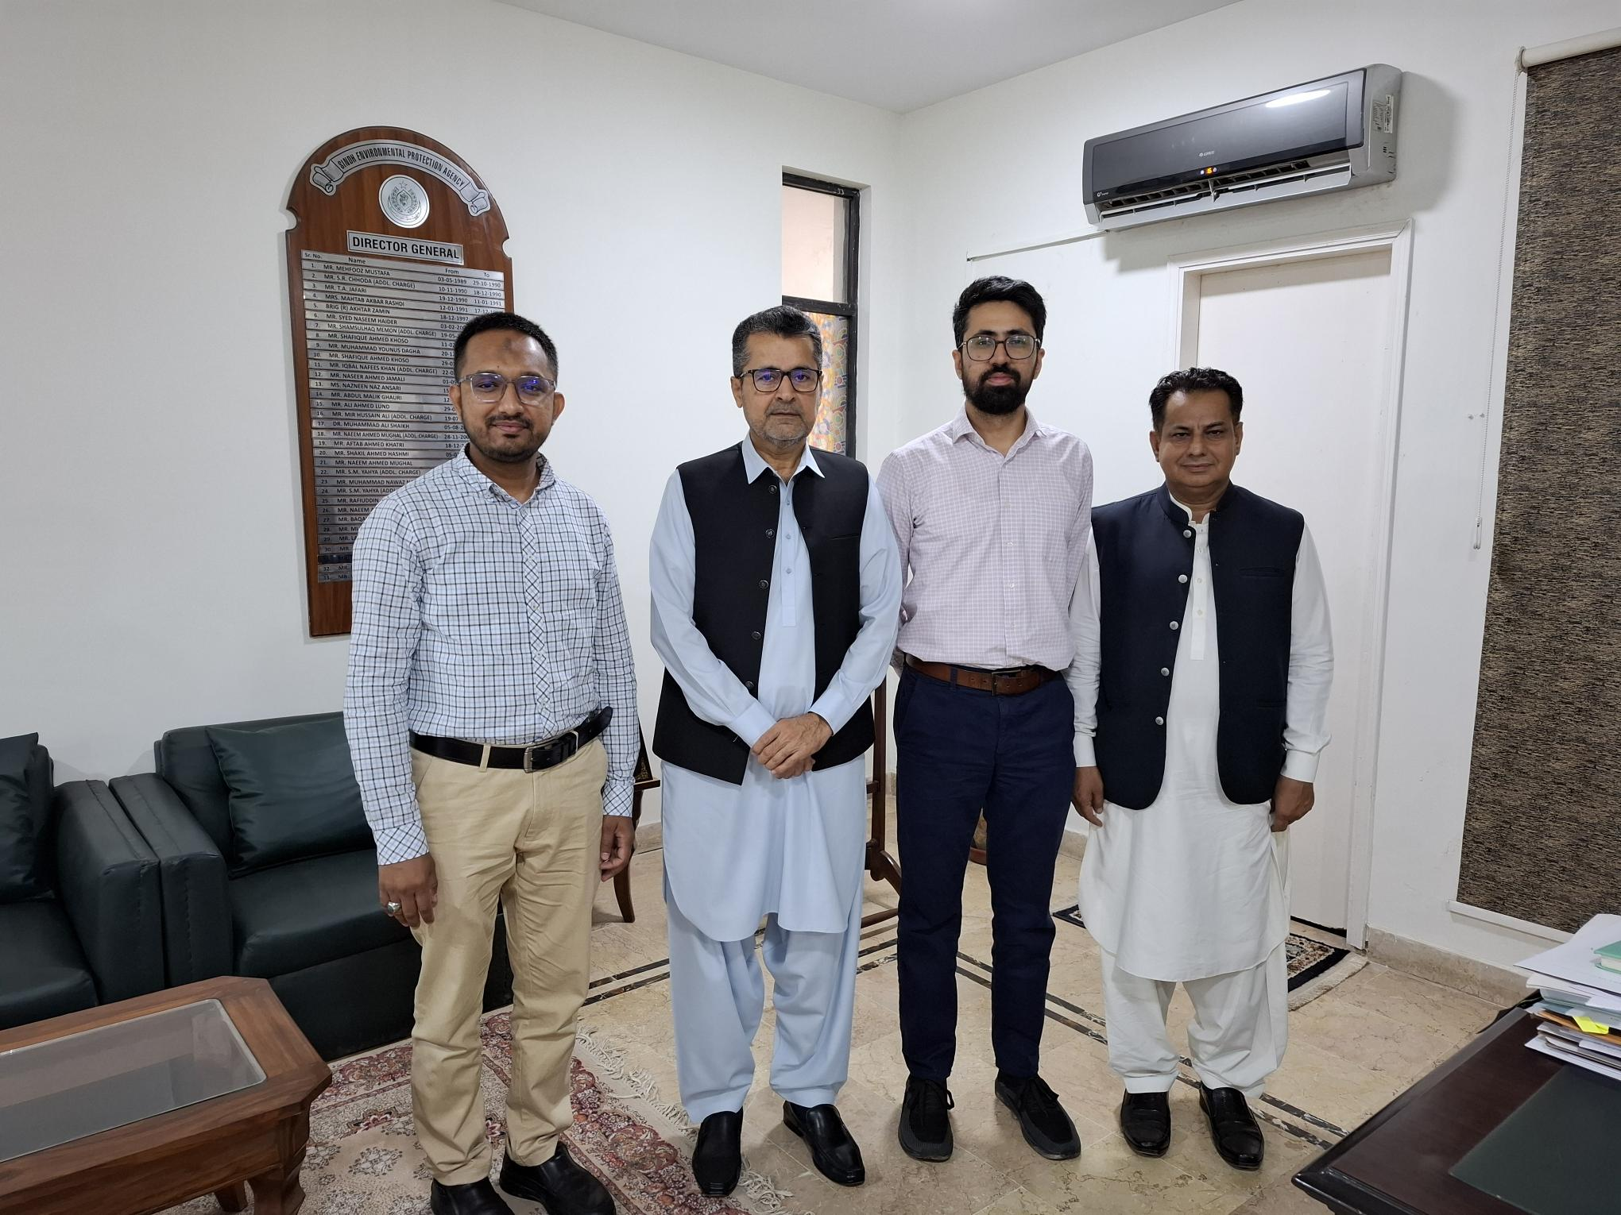
ENGAGEMENT (SEPA)

Slide 11
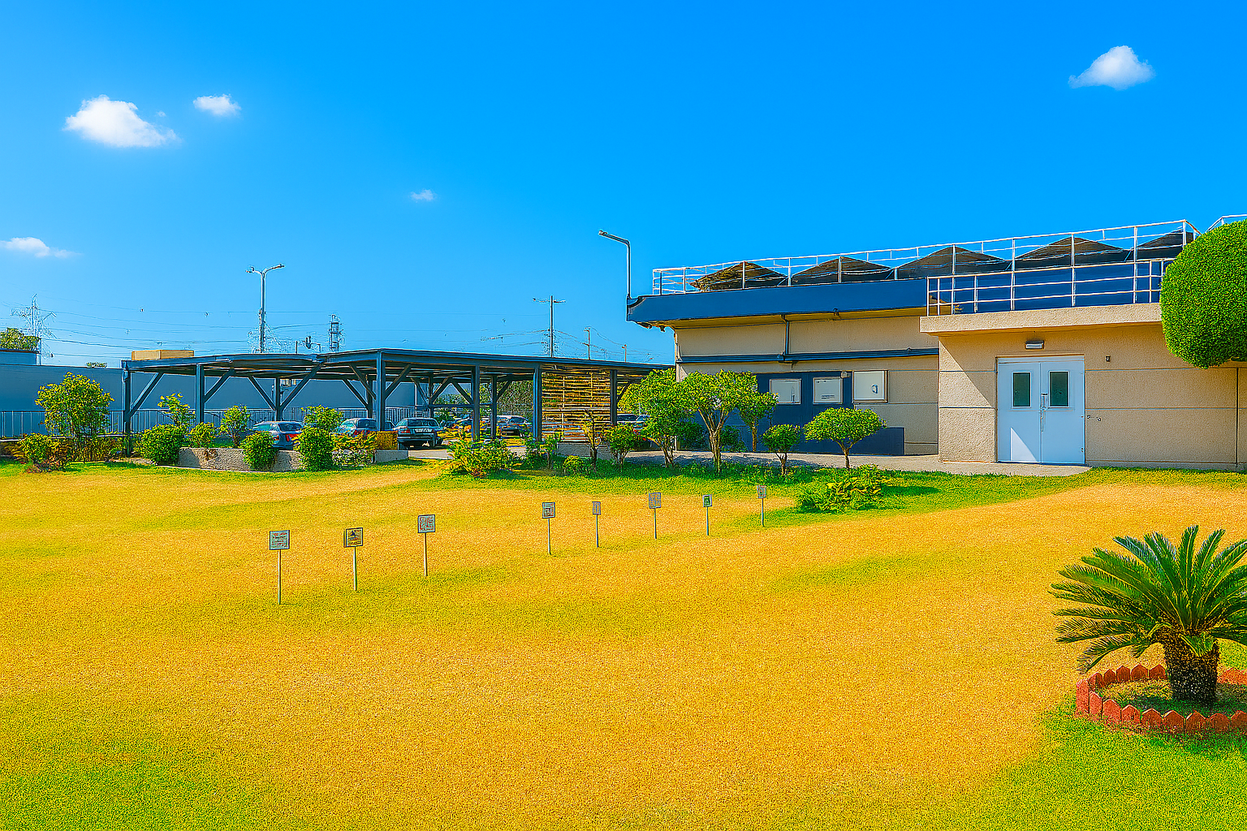

Thank you
شکریہ

