Slide 1
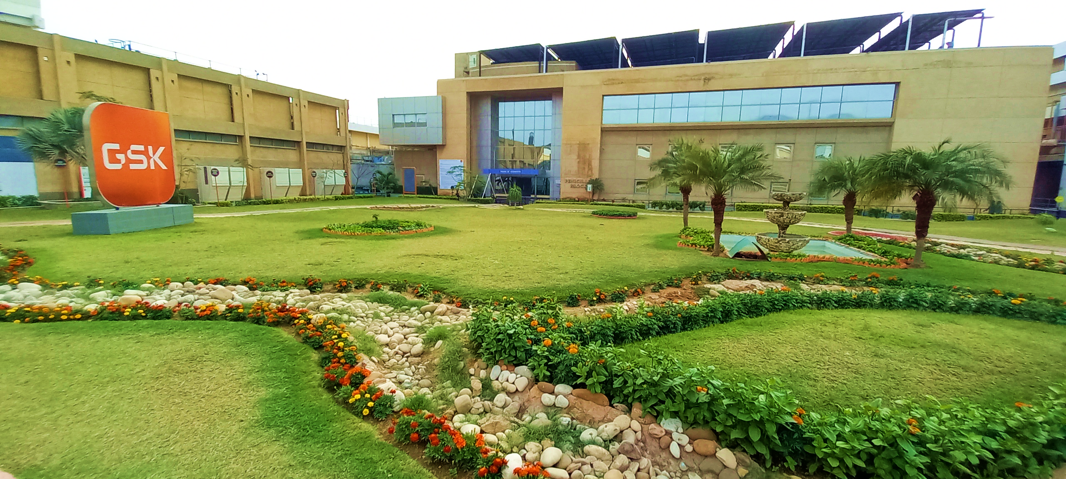

Welcome
Site F-268

Slide 2
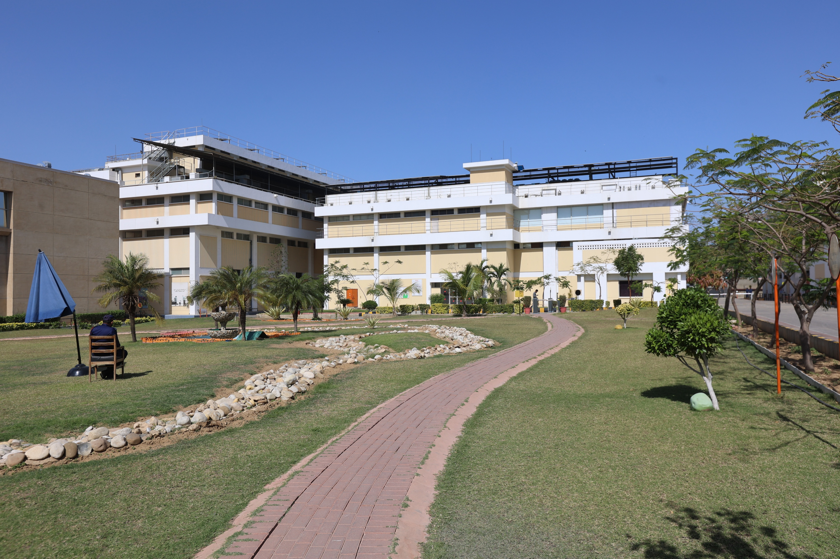
Efforts made by the site to engage stakeholders and coordinate and support public-sector agencies shall be identified.
Stakeholder name | Stakeholder description (businesses, governmental agency, farmers/landowners, supplier, non-governmental organizations, community-based organizations, etc.) | Stakeholder's Impact | Stakeholder's level of Interest in water-related issues
Sindh Environmental Protection Agency (SEPA) | Government agency | High | High
Karachi Water Supply and Sewerage Corporation (KWSC) | Government agency | High | High
Sindh Irrigation Department | Government agency | High | High
Pakistan Oxygen | Industry | High | High
AGP | Industry | Medium | High
Pfizer | Industry | Medium | High
Site Association of Industry | Non-Government Agency | Medium | High
Lucky core industries | Industry | Medium | High
WWF Pakistan | Non-governmental organization (NGO) | Low | High
Site Employees | GSK personnel | High | High
Union Council | Government agency | Medium | High
Ghulam Nabi | Water Contractor | High | High

Slide 3
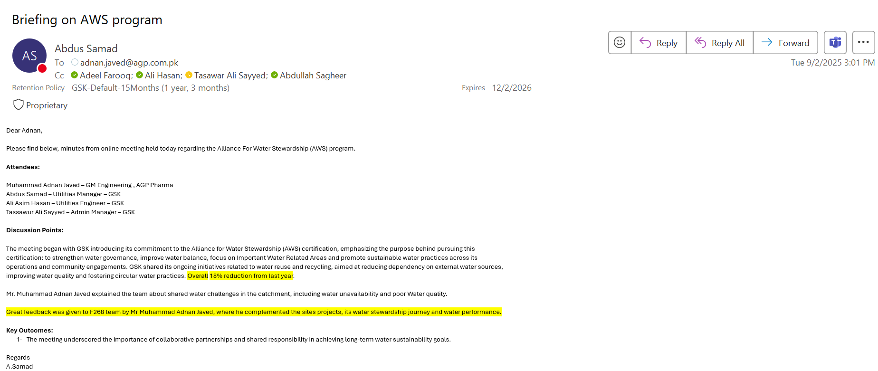
ENGAGEMENT (AGP PHARMA)

Slide 4
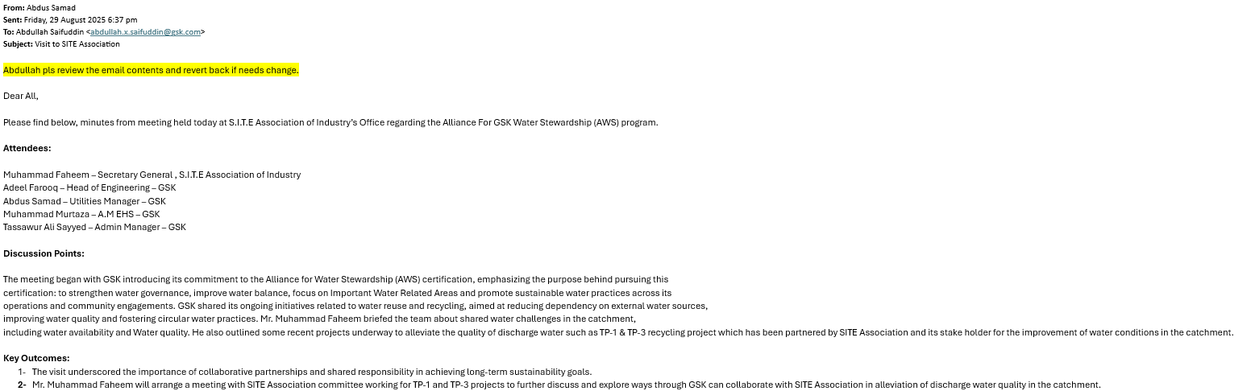
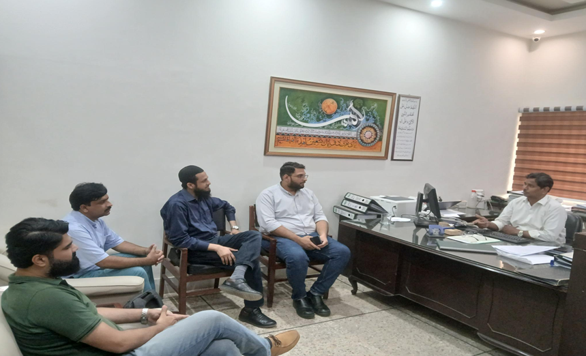
ENGAGEMENT (SITE ASSOCIATION)

Slide 5
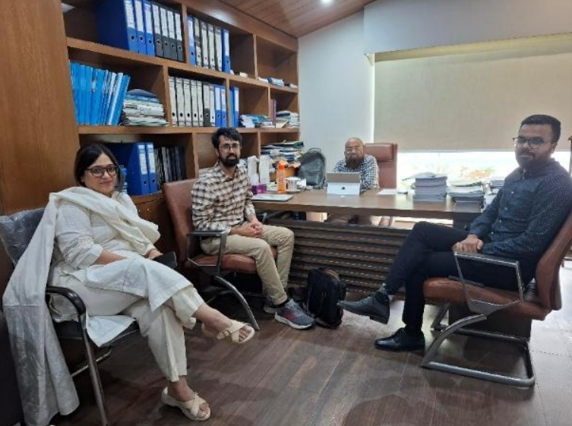
ENGAGEMENTS (SITE ASSOCIATION)
ENGAGEMENT (KWSC)

Slide 6
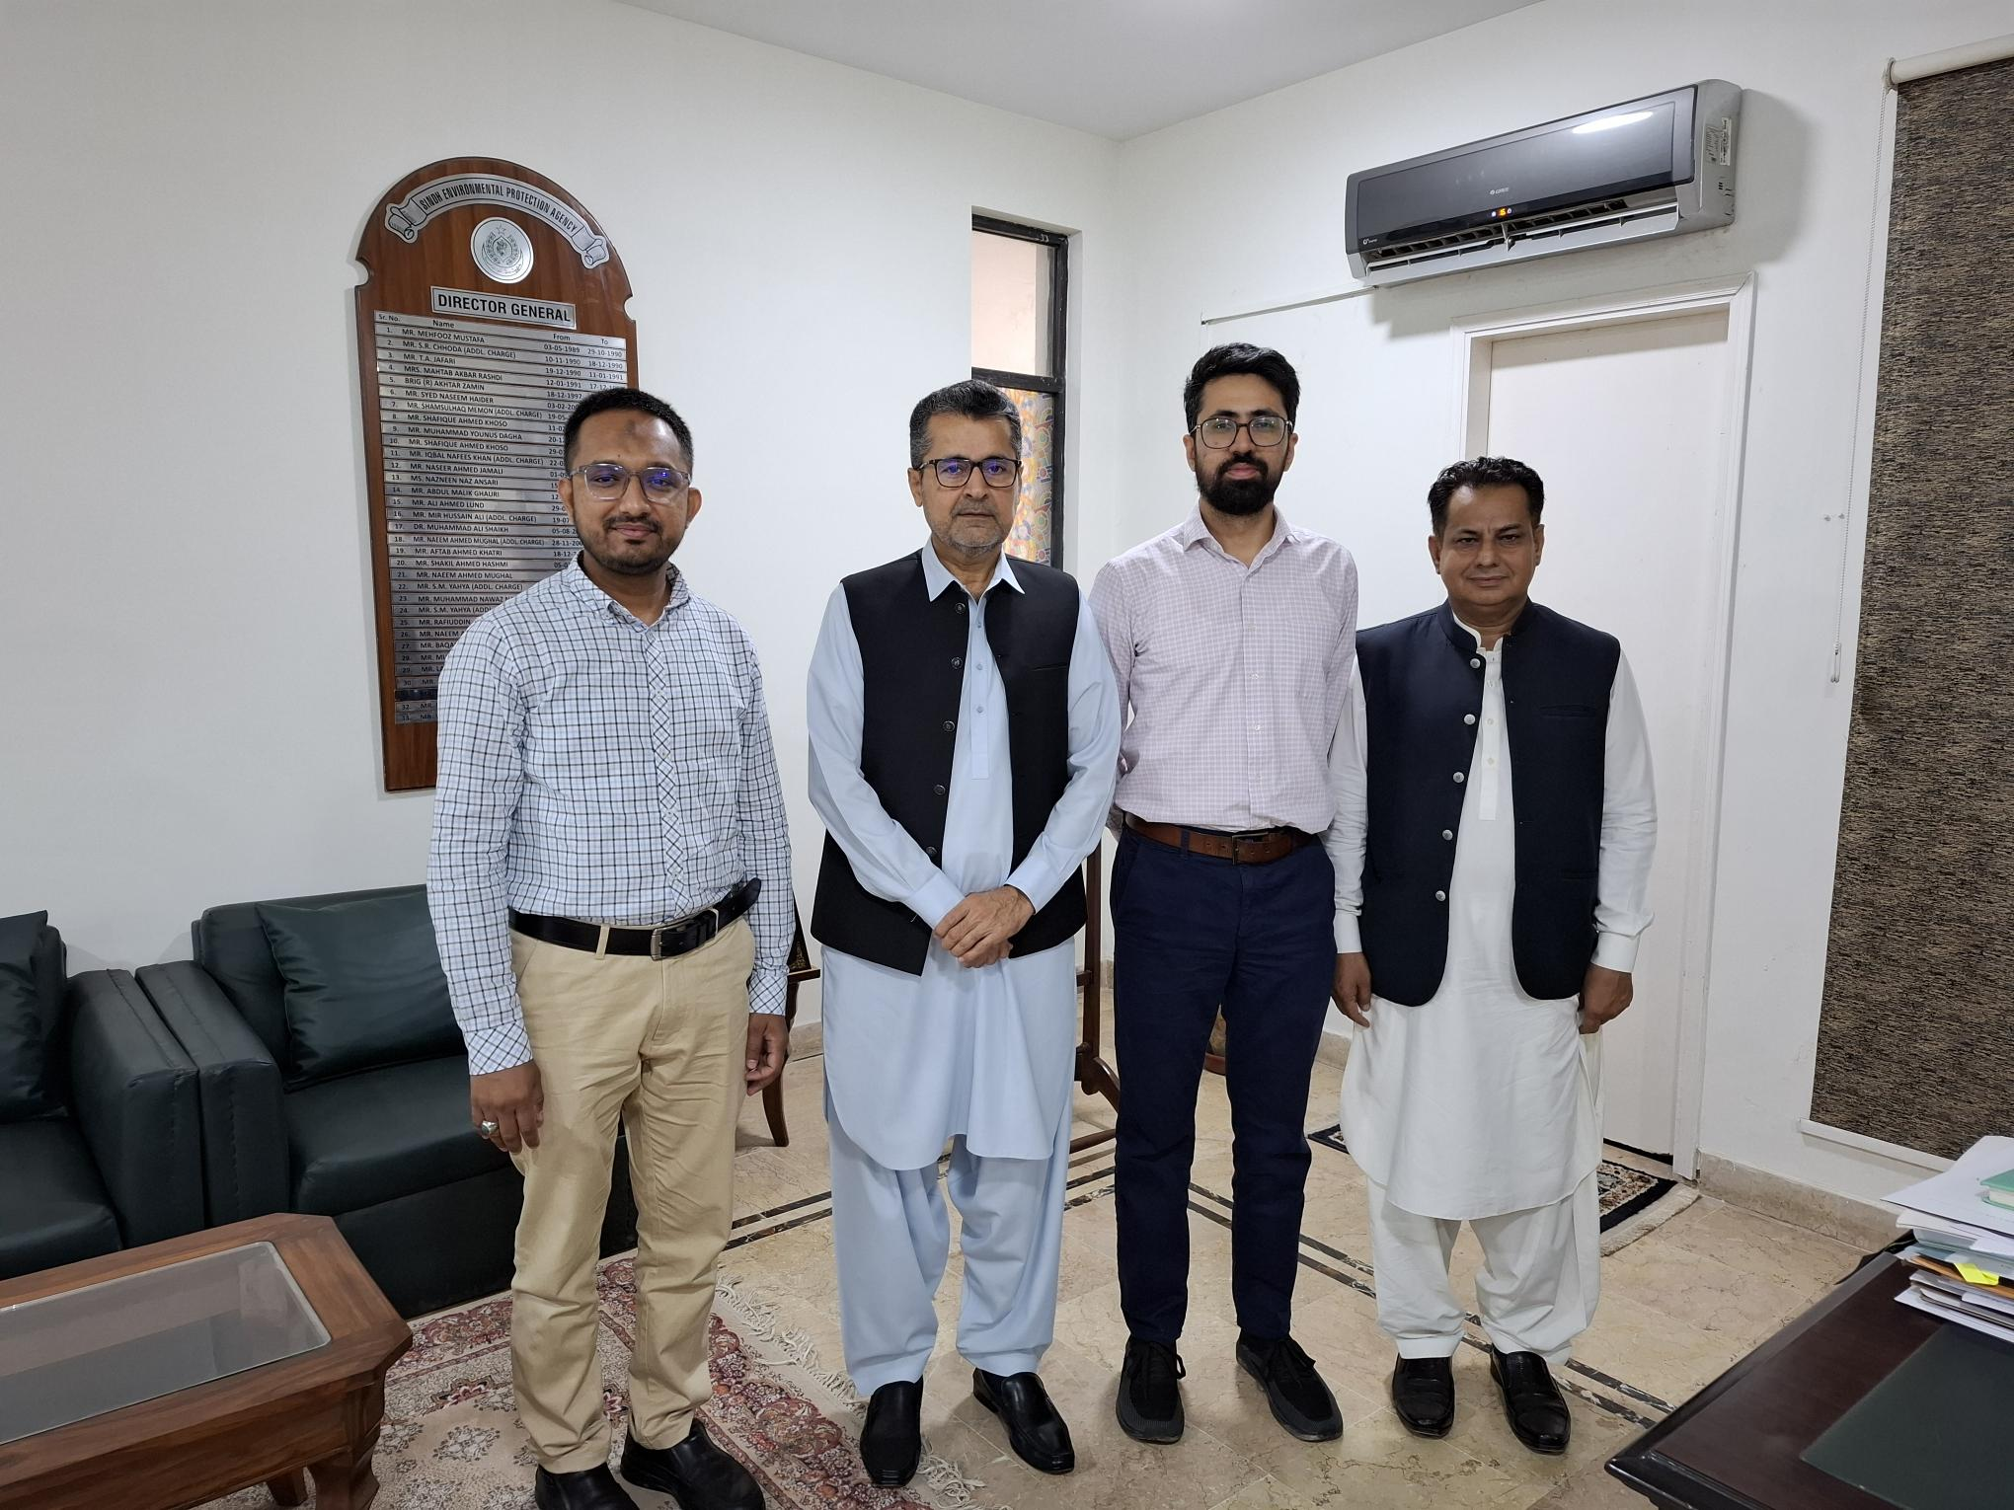
ENGAGEMENTS (SITE ASSOCIATION)
ENGAGEMENT (SEPA)

Slide 7
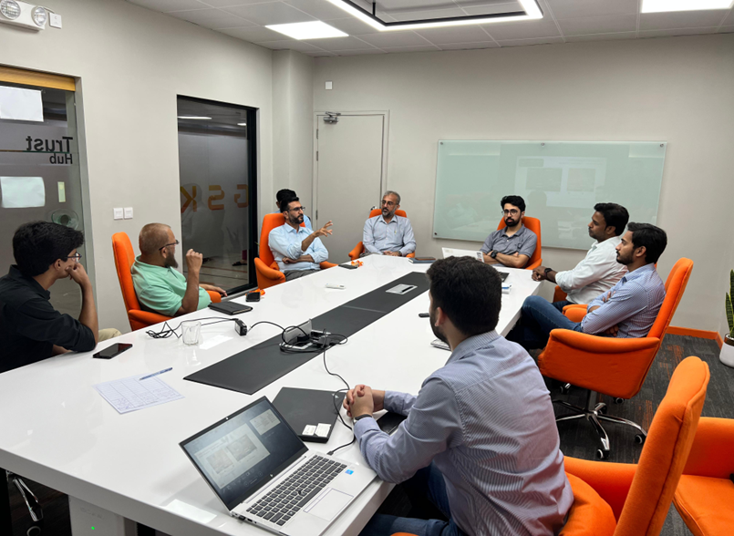
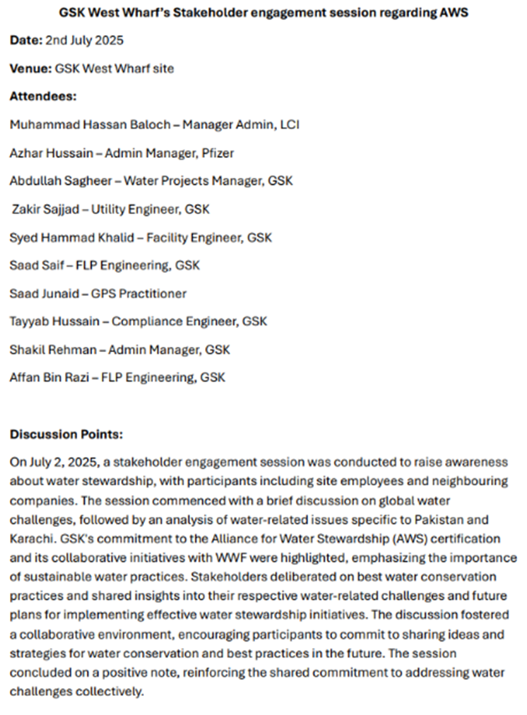
ENGAGEMENTS (SITE ASSOCIATION)
ENGAGEMENT (LCI & Pfizer Pakistan)

Slide 8
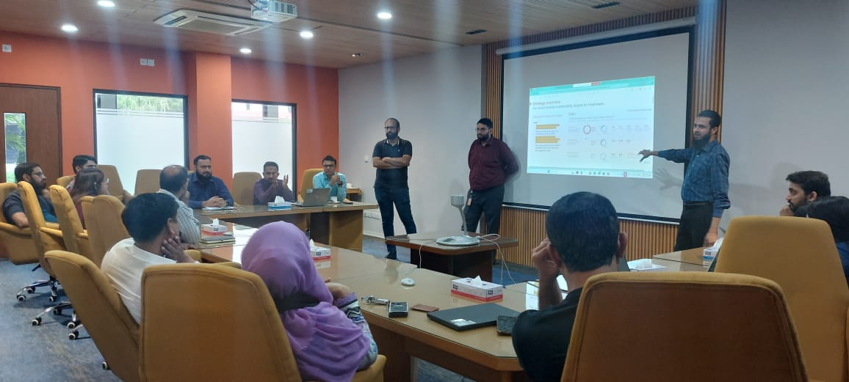
ENGAGEMENTS (SITE ASSOCIATION)
ENGAGEMENT (Site Employee)

Slide 9
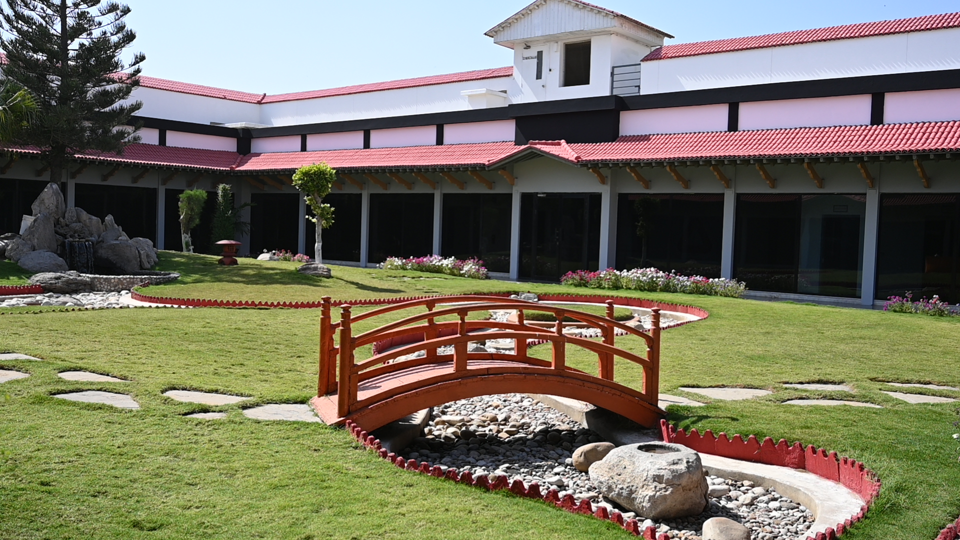

Thank you
شکریہ

